Slide 1
Operating Systems CS2006
Chapter:9
Memory Management
PART-1

Slide 2
Background
Program must be brought (from disk) into memory and placed within a process for it to be run
A programmer will like to have memory
  Infinitely large
  Infinitely fast
  Non volatile
However, we have Memory Hierarchy:
Registers
Cache
Main Memory
Disk

Slide 3
Background
Main memory and registers are only storage CPU can access directly
Memory unit only sees a stream of addresses + read requests, or address + data and write requests
Register access in one CPU clock (or less)
Main memory can take many cycles, causing a stall
Cache sits between main memory and CPU registers
Protection of memory required to ensure correct operation

Slide 4
Memory Manager
The part of the OS that manages the Memory Hierarchy
  Which part of memory is in use and which is not in use
  Allocate memory
  De-allocate memory
  Swapping between main memory and disks

Slide 5
Memory Management Requirements
Speed is not the only issue
  Relocation
  Protection
  Sharing
  Physical memory organization
  ….

Slide 6
Requirements: Relocation
The programmer does not know where the program will be placed in memory when it is executed,
  it may be swapped to disk and return to main memory at a different location (relocated)
Memory references must be translated to the actual physical memory address

Slide 7
Relocation and Protection
Partition 4
Partition 3
Partition 2
Partition 1
Operating System
800K
700K
Different jobs will run at different addresses
Suppose, the first instruction is
  call a procedure at absolute address 10 within the binary file
400K
200K
100K
0
This call will jump inside the Operating system

Slide 8
Relocation and Protection
Partition 4
Partition 3
Partition 2
Partition 1
Operating System
800K
Solution:
If the program is loaded in 1st partition, then
  Call 100k + 10
If the program is loaded in 2nd partition, then
  Call 200k + 10
So on…
This is called Relocation problem
700K
400K
200K
100K
0

Slide 9
Relocation and Protection
Partition 4
Partition 3
Partition 2
Partition 1
Operating System
800K
Solution:
  Add an offset to each address in the program
  The offset depends on the partition, e.g.,
    if the Program is loaded in partition 1, add 100k to every address
    if the Program is loaded in partition 2, add 200k to every address
700K
400K
200K
100K
0
A program can still generate an address that jumps in the OS or other user’s code
We need to Protect the code

Slide 10
Requirements: Protection
Processes should not be able to reference memory locations in another process without permission
Impossible to check absolute addresses at compile time
Must be checked at run time

Slide 11
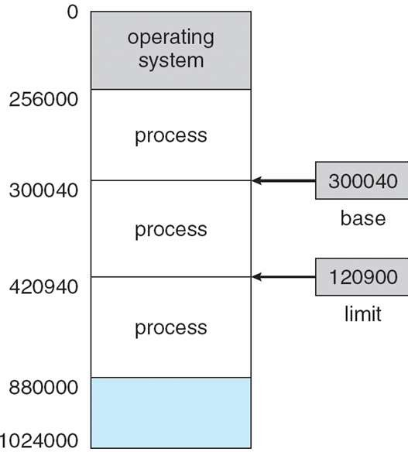
Relocation and Protection
Solution:
  Base and Limit Registers
When a process is scheduled
  Base Register is loaded with the starting address of the Partition
  Limit Register is loaded with the length of the Partition
Before referring to memory
  Add the base register contents to generated memory address
  Also check against the Limit register for protection

Slide 12








Hardware Address Protection
12

Slide 13
Memory-Management Unit (MMU)
Hardware device that at run time maps virtual to physical address
Many methods possible, covered in the rest of this chapter
To start, consider simple scheme where the value in the relocation register is added to every address generated by a user process at the time it is sent to memory
  Base register now called relocation register
  MS-DOS on Intel 80x86 used 4 relocation registers
The user program deals with logical addresses; it never sees the real
physical addresses
  Execution-time binding occurs when reference is made to location in memory
  Logical address bound to physical addresses

Slide 14
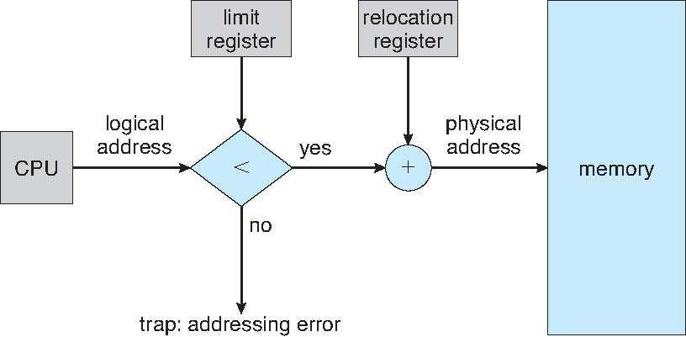
Hardware Support for Relocation and Limit Registers

Slide 15
Logical vs. Physical Address Space
The concept of a logical address space that is bound to a separate
physical address space is central to proper memory management
  Logical address – generated by the CPU; also referred to as virtual address
  Physical address – address seen by the memory unit
Logical and physical addresses are the same in compile-time and load- time address-binding schemes; logical (virtual) and physical addresses differ in execution-time address-binding scheme
Logical address space is the set of all logical addresses generated by a program
Physical address space is the set of all physical addresses corresponding to these logical addressess

Slide 16
Memory Management/Organization
In good old days, memory management was trivial as there was only one program
  No OS, eveything is responsibility of user program
For the later uniprogramming systems, memory was shared between
  A User program
  Operating system
21

Slide 17
Uni-programming
User Program
Run just one program at a time
Memory is shared between
  A User program
  Operating system
Operating System
The user types a command on the prompt
The OS
▪Copies the program from the disk to memory
▪Executes the program
▪After execution, prompt is available again
The new program is copied into RAM, overwriting the previous one

Slide 18
Multi-programming systems
Keep more than one process in memory
  Benefits?
How to organize memory to achieve this?
One basic approach is to divide memory into n partitions

Slide 19
Memory Allocation Mechanisms
Contiguous Memory Allocation
  Fixed or Static Partitioning
  Variable or Dynamic Partitioning
Non-Contiguous Memory Allocation
  Fixed or Static Partitioning (Paging)
  Variable or Dynamic Partitioning (Segmentations)
24

Slide 20
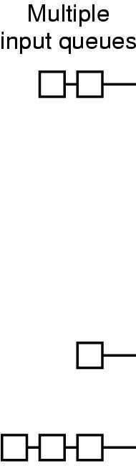
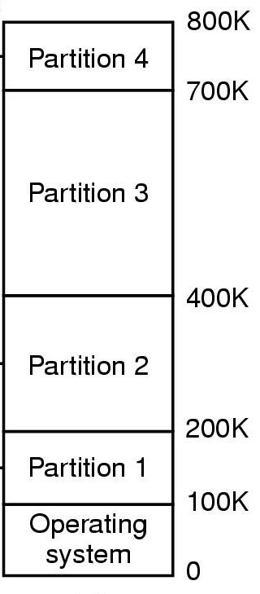
Multiprogramming with Fixed Partitions
If the job size < Partition size, memory is wasted
When a job arrives
▪its put into the input queue of
The smallest partition large enough to hold the job

Slide 21
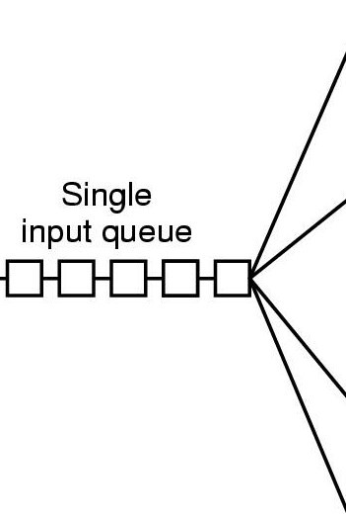
Multiprogramming with Fixed Partitions
Disadvantage of Multiple Queues
  When a large partition is empty
  And queues for small partition is full
  Small jobs have to wait, even though plenty of memory is free
Alternative: Maintain a single Queue
:

Slide 22
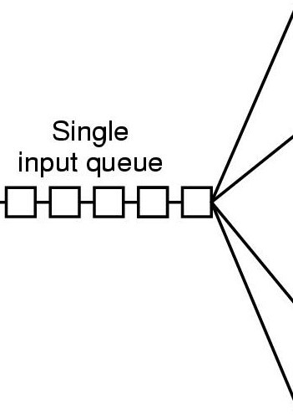
Multiprogramming with Fixed Partitions
Whenever a partition becomes free, a job is selected
  Closest to the front of the queue
  Smaller than the partition size
Undesirable to waste a large partition for smaller job
  Search the queue, find the largest job that fits is
Unfair for smaller jobs
  A job may not be skipped more than
k times
Partition 4
Partition 3
Partition 2
Partition 1
Operating System
800K
700K
400K
200K
100K
0
27

Slide 23
Internal Fragmentation
Memory that is internal to a partition but not being used
800K
B
A
Partition 2
Partition 1
Operating System
Partition 4
External Fragmentation
700K
Partition 3
Internal Fragmentation
400K
200K
100K
0

Slide 24
Swapping
If not enough space in memory for all the currently active processes
Excess processes must be kept on disk
  Fully ➔ Swapping
  Partially ➔Virtual Memory
Example of Swapping
  Round Robin Scheduling
When the quantum expires
  Swap out the currently running process
  Swap in another process to freed memory space

Slide 25
Swapping
Another Example:
  Priority based scheduling
If a higher priority process arrives
  Swap out a lower priority process
  Swap in the higher priority process
When the higher priority process exits
  Swap in the lower priority process
30

Slide 26
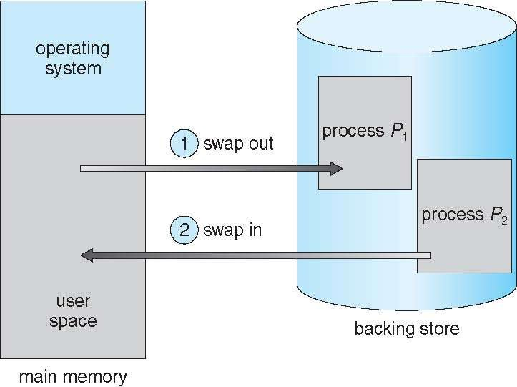
Schematic View of Swapping
31

Slide 27
Swapping
The number, size and location of the partition is decided dynamically.
C
D
B
B
A
C
A
A
D
Operating
System
D is of Higher Priority, A is of Lower Priority!!!
B exits now, Swap in A
32

Slide 28
Swapping
Its possible to combine all the holes into one big hole
This is called COMPACTION
EXTERNAL FRAGMENTATION
Memory External to all partitions is Fragmented Enough total memory exists to satisfy the request
But is not Contiguous
E
C
E
A
Swapping has created Holes
D
Operating
System
D exits now No Space for E !!!
Now E has enough space

Slide 29
Compaction
Compaction involves CPU overhead
If addresses are not generated relative to the partition location:
  Then Compaction is not possible
How much memory should be allocated for a process?
  If all the memory is allocated statically in a program
  Then, OS knows exactly the amount of memory to be allocated: executable code + variables
However, if memory is allocated dynamically (say using new)

Slide 30
Memory allocation for Processes
Problem may occur whenever a process tries to grow
If a hole is adjacent to the growing process then it can be allowed to grow
If another process is adjacent to the growing process, then
  The growing process should be moved to a larger hole
  If a larger hole is not available, then, one or more processes should be swapped out
  If a process cannot be swapped out (say, there is not enough space on disk
    The growing process has to wait
    Or should be killed!!!

Slide 31
Memory allocation for Processes
If most of the processes grow as they run,
It is better to allocate a little extra memory for a process
Room for growth Actual in use
B
Room for growth Actual in use
A
Operating System

Slide 32
Memory allocation for Processes
If processes have two growing segments
  Data
    (as heap for dynamically allocated variables)
Stack
B-Stack
Room for growth
B-Data
The memory can be used by either of the two segments
If it runs out the process either
▪Has to be moved to a larger hole
▪Or swapped out
▪Or Killed
B-Program
A-Stack
Room for growth
A-Data
A-Program
Operating System
37

Slide 33
How to keep track of Memory
We need to keep track of
  Allocated memory
  Free memory
Memory management with bitmaps
Memory management with linked lists

Slide 34
Memory management with bitmaps
Memory is divided up into allocation units
  Few words
  Or several kilobytes
A.
. . .
B C
D
E
8
16
24
1 | 1 | 1 | 1 | 1 | 0 | 0 | 0
1 | 1 | 1 | 1 | 1 | 1 | 1 | 1
1 | 1 | 0 | 0 | 1 | 1 | 1 | 1
1 | 1 | 1 | 1 | 1 | 0 | 0 | 0
... … …
0
0
0
0
0
0
0
0
0
0
0
0
0
0
0
0
0
0
0
0
0
0
0
0

Slide 35
Memory management with bitmaps
Size of allocation unit is important
Smaller allocation unit
  Larger bitmap required
Larger allocation unit
  Smaller bitmap required
  More memory will be wasted
    If the process size is not an exact multiple of the allocation unit
40

Slide 36
Memory management with bitmaps
To bring a k unit process in memory
Search for a k run consecutive 0 bits in the map
Search can be slow
Since, k run may cross word boundaries
1 | 1 | 1 | 1 | 1 | 0 | 0 | 0
1 | 1 | 1 | 1 | 1 | 1 | 0 | 0
0 | 0 | 1 | 1 | 1 | 1 | 1 | 1
1 | 1 | 1 | 1 | 1 | 0 | 0 | 0
... … …
Find run of length = 3
Find run of length = 4
0
0
0
0
0
0
0
0
0
0
0
0
0
0
0
0
0
0
0
0
0
0
41

Slide 37

Memory management with Linked Lists
Linked list of memory segments
  Free segments ➔ Holes
  Allocated segments ➔ Processes
A.
. . .
B C
D
E
8
16
24
P 0 5
H
5 3
P
8 6
P 14 4 .
H 18 2
P 20 6
_{P}CS-₂20₆06 O₃perating Systems
42

Slide 38
Memory management with Linked Lists
Segment list is sorted by addresses
Sorting helps in updating the list, when a process is swapped out or exits
A process usually has two neighbors
Updating the list requires
A.
X
B
➔
A.
. . .
B
Replace P by H
. . .
A.
X
➔
➔
 |  | A.
Two entries are merged
. . .
. . .
.
.
.
X
B
. | . | . | . | . |  |  |  |  |  | B
Two entries are merged
. . .
. . .
 |  | . | . | . |  | X
➔
. | . | . | . | .
Three entries are merged
. . .
. . .

Slide 39
Memory Allocation with Linked Lists
Several algorithms for allocating memory with linked list
FIRST FIT:
  Scan the segment list, until
  A hole large enough is found
  Split the hole into two pieces (if not exact match)
  One for the new process
  One for the unused memory
The algorithm is fast since it searches as little as possible

Slide 40
Memory Allocation with Linked Lists
NEXT FIT
  Works the same as First Fit, except,
  Does not always start searching from the beginning
  Rather starts searching the list, from where it left last time
Simulations show, that gives no better performance than First Fit

Slide 41
Memory Allocation with Linked Lists
BEST FIT
  Search the entire list
  Take the smallest hole that is adequate
Best Fit tries to find the hole closest to the size of Process
Slower than First Fit
  Every time has to search the entire list
But still results in more memory wastage
  Tends to fill up memory, with tiny useless holes
  First Fit generates larger holes on the average

Slide 42
Memory Allocation with Linked Lists
WORST FIT
  Take the largest hole available
  So that, the hole broken off will be large enough to be useful
  What if the larger holes left by worst fit are not useful
  ➔ more memory wasted than Best Fit
47

Slide 43
References
Chapter 3, Modern Operating System
http://cseweb.ucsd.edu/classes/sp00/cse120_A/mem. html
Operating System Concepts (Silberschatz, 9th edition) Chapter 8
48

